Slide 1

A Project Review Meeting on The Hotel Banquet Hall and Meeting room Booking System
By
Name Akshaya roll 2520030143
Name keerthi roll 2520030416
Team Number:
Under the guidance of
Rakesh K
Department of Computer Science and Engineering
Koneru Lakshmaiah Education Foundation (Deemed to be University estd. u/s. 3 of the UGC Act, 1956) Off-Campus: Bachupally-Gandimaisamma Road, Bowrampet, Hyderabad, Telangana - 500 043. Phone No: 7815926816, www.klh.edu.in

Slide 2
Outline of the Presentation
Abstract
Introduction
Problem Statement
Project Flow Diagram
Objectives with Justification
Modules[Frontend web pages]
Expected Outcomes of the Proposed Work
Conclusion
References

Slide 3
Abstract
Web-based system for booking hotel banquet halls and meeting rooms.
Enables customers to check availability and make reservations online.
Reduces manual booking processes and paperwork. Helps prevent scheduling conflicts and booking errors.
Provides details about hall capacity, facilities, and pricing. Allows administrators to manage bookings efficiently.
Developed using HTML, CSS, JavaScript, React.js, and Node.js.
Improves customer convenience and hotel resource management. Maintains accurate booking records and reservation schedules.
Can be enhanced with online payments, notifications, and database integration

Slide 4
Introduction
The Hotel Banquet Hall and Meeting Room Booking System is a web-based application designed to simplify venue reservations in hotels.
It enables customers to book banquet halls and meeting rooms online without visiting the hotel physically.
The system provides information about hall availability, capacity, facilities, and pricing.
It helps customers select suitable venues for weddings, conferences, business meetings, seminars, parties, and other events.
The application reduces manual paperwork and minimizes booking errors and scheduling conflicts.
It provides a faster and more efficient booking process for both customers and hotel management.
The system allows administrators to manage bookings, schedules, and venue availability effectively. The project is developed using HTML, CSS, JavaScript, React.js, and Node.js technologies.

Slide 5
Problem Statement
Many hotels still use manual methods for managing banquet hall and meeting room bookings.
Manual booking systems often lead to scheduling conflicts, double bookings, and human errors.
Customers need to visit or contact the hotel to check hall availability and make reservations, which is time-consuming.
Maintaining booking records manually increases administrative workload and reduces efficiency.
Lack of a centralized booking system makes it difficult to track reservations and venue availability in real time.
Customers may face delays in receiving booking confirmations and updated information
Managing multiple banquet halls and meeting rooms simultaneously becomes challenging for hotel staff.
There is a need for an automated system that simplifies the reservation process and improves booking accuracy.

Slide 6
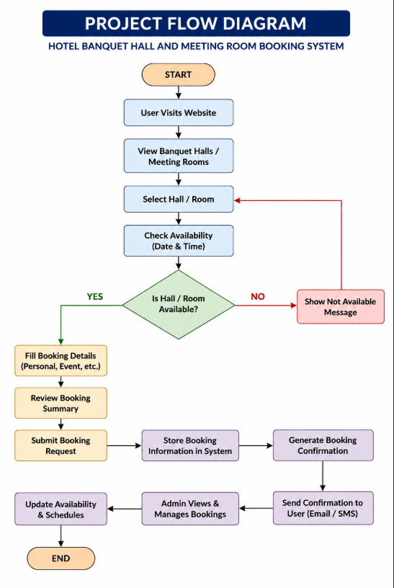
Project Flow Diagram

Slide 7
Objectives with Justification
Objective 1: Develop a user-friendly venue booking platform.
Justification: A simple and intuitive interface helps users easily search, view, and book banquet halls or meeting rooms without technical difficulties.
Objective 2: Provide detailed venue information.
Justification: Displaying venue details such as capacity, pricing, location, and amenities enables users to make informed booking decisions.
Objective 3: Implement an efficient booking management system.
Justification: A centralized booking system reduces manual work, minimizes errors, and streamlines reservation processes.
Objective 4: Ensure smooth navigation and user experience.
Justification: React-based routing and reusable components improve application performance and make navigation faster and more responsive.
Objective 5: Manage booking data effectively.
Justification: State management using React Context API allows consistent and efficient handling of booking information across the application.
Objective 6: Create a scalable and maintainable front-end architecture.
Justification: Component-based development promotes code reusability, easier maintenance, and future enhancements.
Objective 7: Improve accessibility and convenience for customers.
Justification: An online booking system allows users to check venue availability and make reservations anytime from any location.
Objective 8: Support future integration of advanced features.
Justification: The system architecture can be extended to include online payments, notifications, user authentication, and AI-based recommendations in future versions.

Slide 8
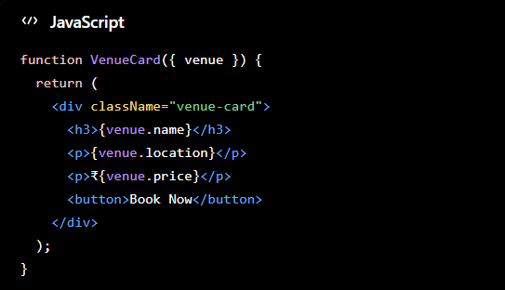
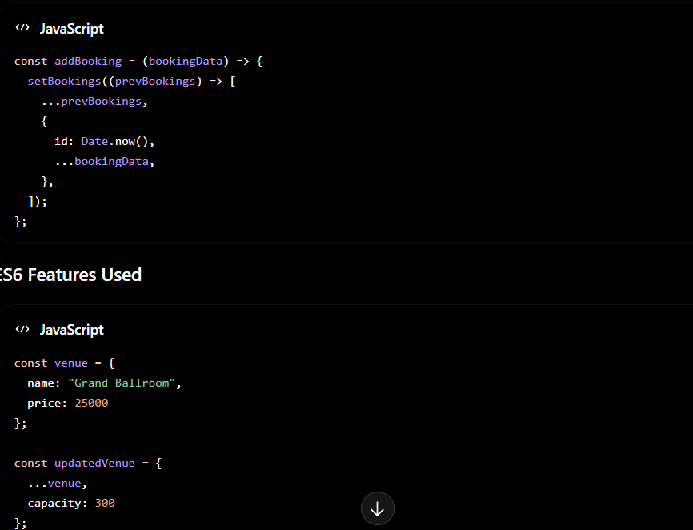
Modules [Frontend web pages]
CO1 – Front-End Architecture & Component-Driven Design
CO2 – ES6+ JavaScript Features

Slide 9
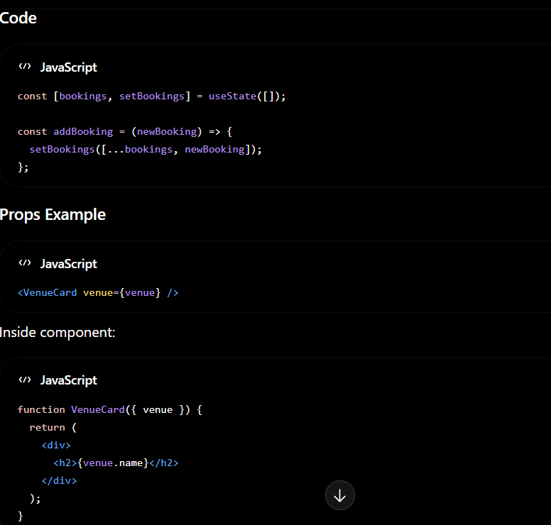
CO3 – React Components, Props and State

Slide 10
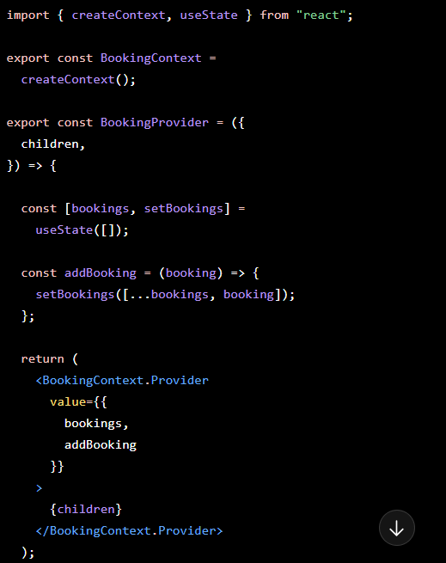
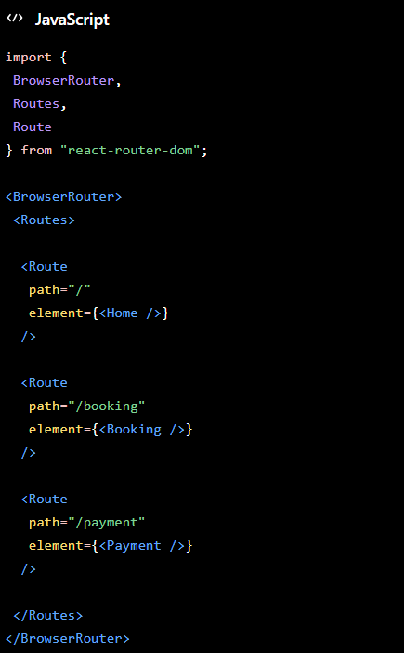
CO4 – State Management & Data Flow CO5 – Routing, Forms & Validation

Slide 11
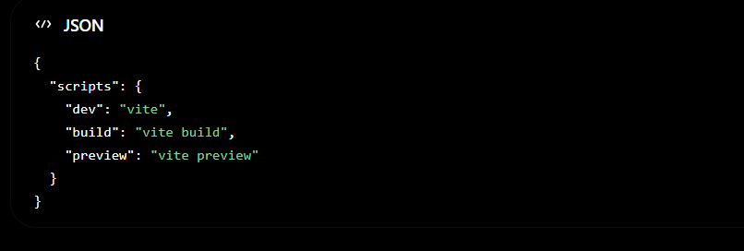
CO6 – Production Readiness & Deployment

Slide 12
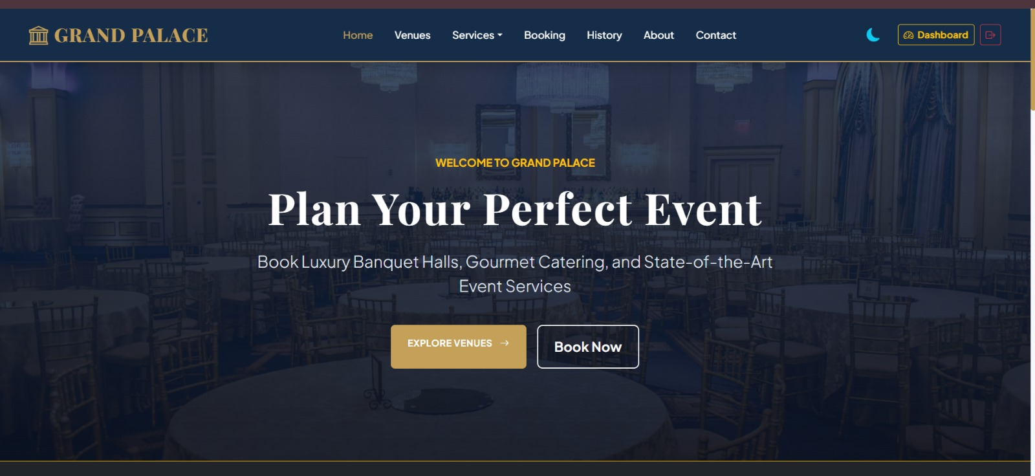
Expected Outcomes of the Proposed Work

Slide 13
Conclusion and Future Scope
Conclusion
The Hotel Banquet Hall and Meeting Room Booking System is a React-based web application that simplifies venue booking and management. It provides an easy-to-use interface for viewing venues, checking availability, and making reservations. The project successfully applies modern front-end development concepts such as React components, state management, routing, and form handling to deliver an efficient booking experience.
Future Scope
Integrate secure online payment gateways.
Add user login and registration features.
Implement real-time hall availability tracking.
Send booking confirmations through email/SMS.
Add customer reviews and ratings.
Develop a mobile application version.
Use AI-based recommendations for venue selection.

Slide 14
References
References
React Official Documentation
Vite Official Documentation
React Router Documentation
MDN Web Docs – JavaScript (ES6+)
W3Schools React Tutorial
Bootstrap Documentation (if Bootstrap was used)
Node.js Documentation
GitHub Documentation
Reference Books
Learning React
React Up & Running
Eloquent JavaScript
JavaScript: The Definitive Guide
These 8 web references + 4 books are more than sufficient for a mini-project PPT/report

Slide 15
Thank you

